Slide 1
Common Core State Standards Symposium for Special Educators
Aligning the Individualized Education Program to the CA CCSS
Kevin Schaefer
Senior Program Associate/WestEd
December 2nd, 2013

Slide 3
Educational Benefit
Standards for Mathematical Practices
College/Career Readiness Anchor Standards
FAPE in the LRE
Progress Indicators
Webb’s Depth of Knowledge
Learning Targets
Bloom’s Taxonomy
Common Core State Standards
Universal Design for Learning
Hess’ Cognitive Rigor Matrix
Individualized Goals and Objectives

Slide 4
“To pursue the bright spots is to ask the question, ‘What’s working, and how can we do more of it?’”

Slide 6
NCSC’s Commitment to Communicative Competence
Communication at some level is possible and identifiable for all students regardless of functional “level,” and is the starting point for developing communicative competence. Communication competence is defined as the use of a communication system that allows students to gain and demonstrate knowledge. Many people with severe speech or language problems rely on alternative forms of communication, including augmentative and alternative communication (AAC) systems, to use with existing speech or replace difficult to understand speech.
NCSC Parent Materials September 2013.
http://www.ncscpartners.org/Media/Default/PDFs/Resources/Parents/NCSC-Communicative-Competence-9-10-13.pdf

Slide 7
IEP Alignment

Slide 12
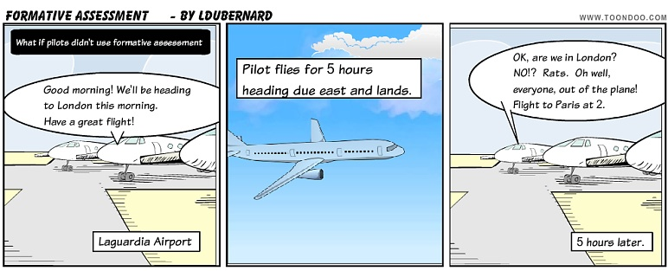
Formative Assessment Gets Us Where We Want to Go

Slide 13
“Formative assessment – encompasses all those activities undertaken by teachers, and/or by their students, which provide information to be used as feedback to modify the teaching and learning activities are engaged.”

Slide 14
“An assessment functions formatively to the extent that evidence about student achievement is elicited, interpreted, and used by teachers, learners, or their peers to make decisions about the next steps in instruction that are likely to be better, or better founded, than the decisions they would have made in the absence of that evidence.”

Slide 16
Educational Benefit and the IEP

Slide 17
When writing goals and objectives, ask:
“How will the student demonstrate mastery?”
Given What
Under What Conditions
With which adaptations

Slide 18
Individualize goals and objectives by:
“How will the student demonstrate mastery?”
Unpack it
Combine it
Verb it

Slide 19
Individualize goals and objectives by:
“How will the student demonstrate mastery?”
Increase independence
Decrease support (appropriately)
Trellis

Slide 21
An integrated model of literacy
Although the Standards are divided into Reading, Writing, Speaking and Listening, and Language strands for conceptual clarity, the processes of communication are closely connected, as reflected throughout this document. For example, Writing standard 9 requires that students be able to write about what they read. Likewise, Speaking and Listening Standard 4 sets the expectation that students will share findings from their research.
-Sacramento County of Education CCSS Document p. 3

Slide 22
CCSS RL – Integrated Literacy
Find references to “prompting and support”
RL.K-12.4: reference to L.K-12.4-6
RL.K-2.5: differentiates between RL and RI
RL.K-5.8: is not applicable
RL.3&4.5: integrates writing and speaking
RL.2.6: integrates speaking
RL.4.7: integrates speaking (oral presentation receptive language)
Note executive functions and ask, “under what conditions will the student demonstrate mastery?

Slide 25
CCSS RI – Integrated Literacy
RI.K-12.4: reference to L.K-12.4-6
RI.4-12.7: integrates listening (info. orally presented)
RI.4&5.9: integrates writing and speaking
RI.2-5.10: integrates history/social studies, science and technical texts
Note executive functions and ask, “under what conditions will the student demonstrate mastery?”

Slide 26
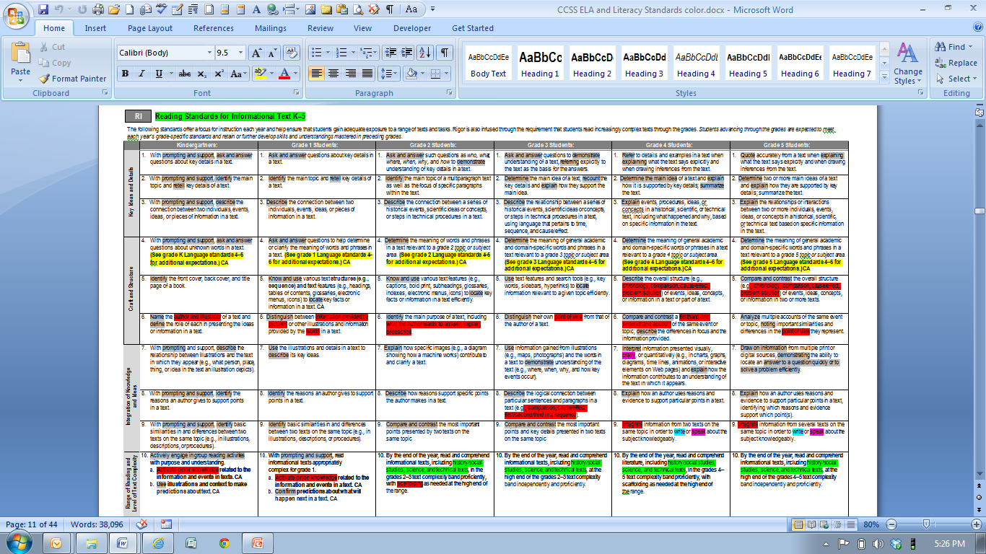

Slide 27
CCSS RF – Integrated Literacy
RF.K.1-3: note emphasis on spoken words/ phonemic awareness
RF.1.2: note the emphasis on spoken words/ phonemic awareness
RF.1-5.3&4: note progression from spoken words/ phonemic awareness to spelling/sound relationships to decoding/reading
Consider language-based disabilities (auditory processing) when addressing phonemic awareness

Slide 28
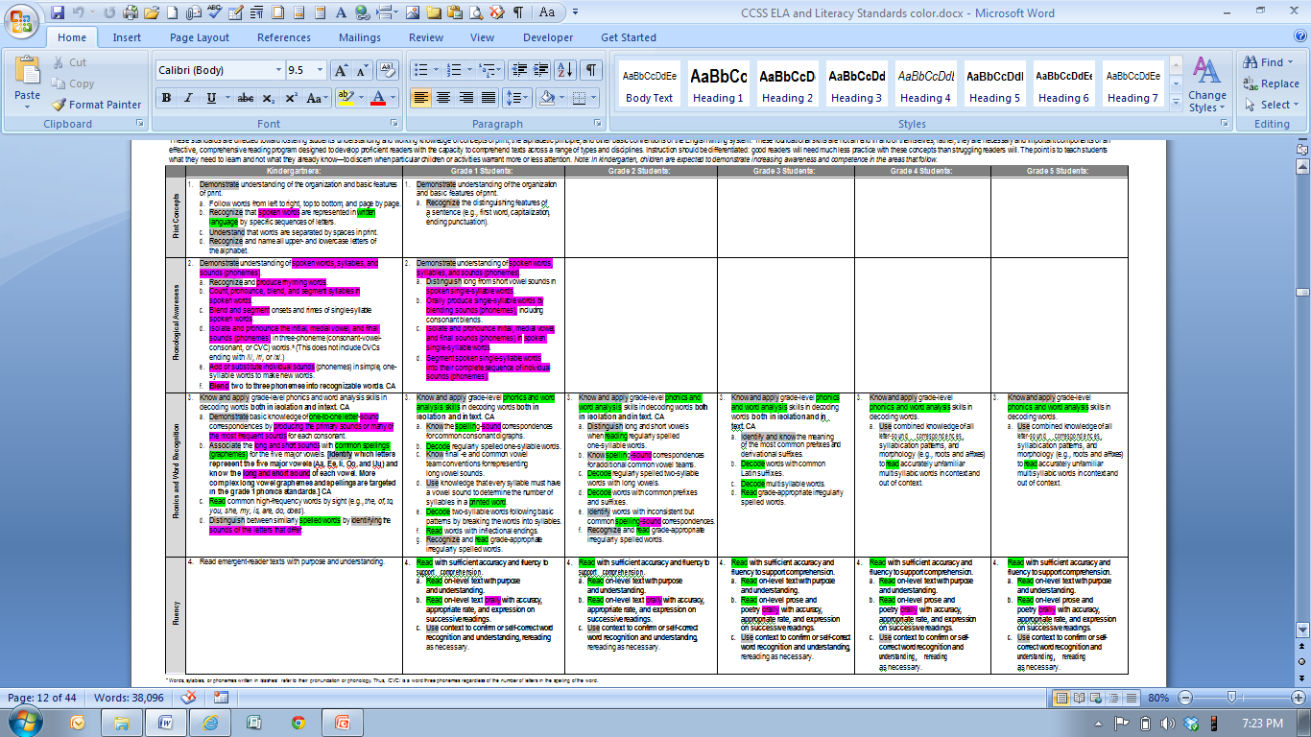

Slide 29
CCSS W – Integrated Literacy
Find references to “guidance and support”
W.K-12.1-3: lists types of writing as 1.opinion/argument; 2.informative/explanatory; 3.narrative
W.6-12.1: “opinion” pieces change to “argument”
W.2-12.4: references “Grade-specific expectations for writing types are defined in writing standards 1-3”
W.3-12.5: references “Editing for conventions should demonstrate command of L standards 1-3”
Reading expectations are included: W.3-12.8 and W.4-12.9
Executive functions are numerous and critical

Slide 30
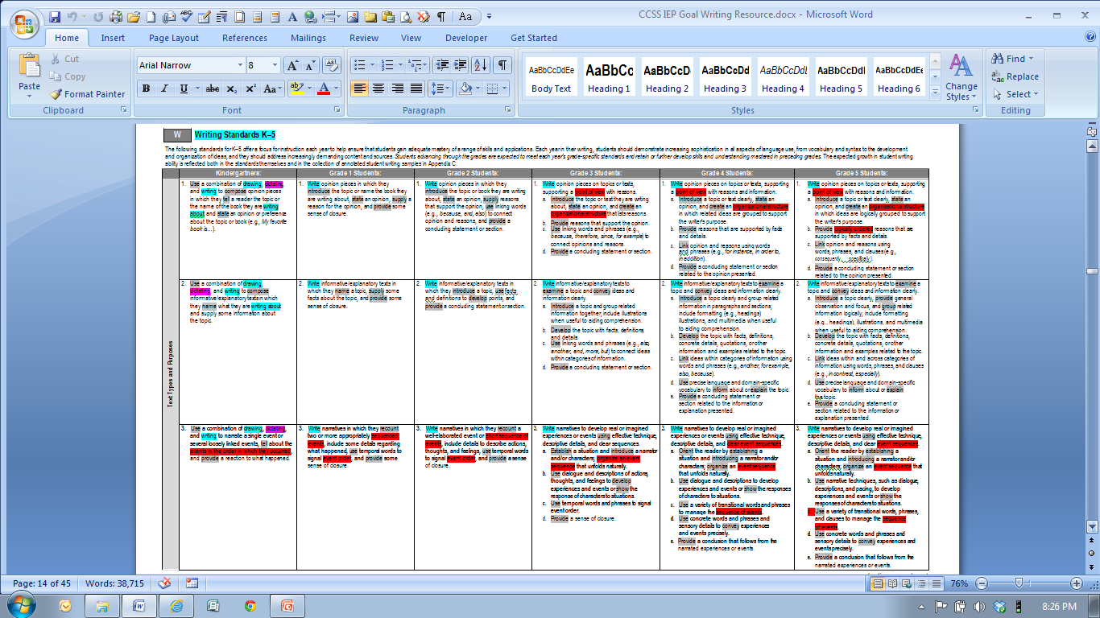

Slide 32
CCSS SL – Integrated Literacy
Reading expectations are included: SL.3-12.1
Writing (fine motor) expectations are included: SL.K-5.5
Language expectations are included: SL.1-12.6
Consider language-based disabilities (auditory processing) when addressing oral, i.e., expressive/receptive language
Executive functions are numerous and critical

Slide 33
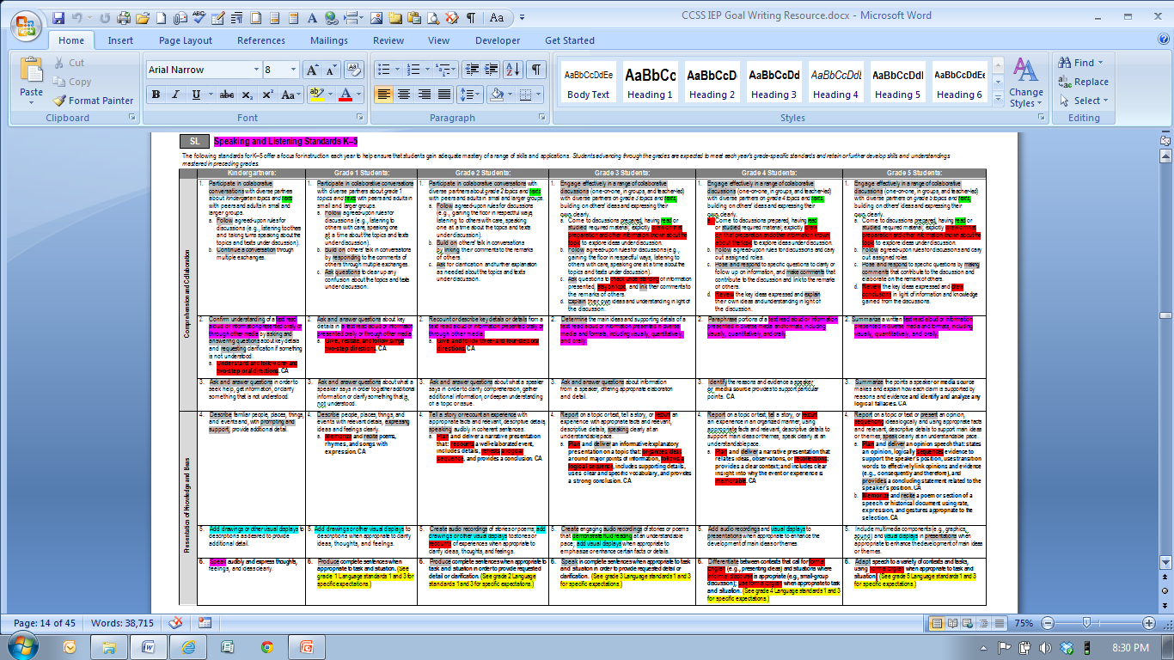

Slide 34
CCSS L – Integrated Literacy
Reading AND speaking expectations are included: L.K-12.1
Writing/spelling expectations are included: L.K-12.2
Reading, writing, AND speaking and listening expectations are included: L.2-12.3 and L.9-12.6
Reading and speaking and listening expectations are included: L.K-3.6
Executive functions are numerous and critical

Slide 37
Prompting
https://wiki.ncscpartners.org/mediawiki/index.php/Instructional_Resource_Guide

Slide 38
BLOOM’S TAXONOMY
Remembering | Understanding | Applying | Analyzing | Evaluating | Creating
Can the student recall or remember the info.? define duplicate list memorize recall repeat reproduce state | Can the student explain ideas or concepts? classify describe discuss explain identify locate recognize report select translate paraphrase | Can the student use the info. in a new way? choose demonstrate dramatize employ illustrate interpret operate schedule sketch solve use write. | Can the student distinguish between the different parts? appraise compare contrast criticize differentiate discriminate distinguish examine experiment question test | Can the student justify a stand or decision? appraise argue defend judge select support value evaluate | Can the student create new product or point of view? assemble, construct create design develop formulate write

Slide 39
CCSS – Depth of Knowledge
Focuses on complexity of content standards in order to successfully complete an assessment or task. The outcome (product) is the focus of the depth of understanding.
The Depth of Knowledge is NOT determined by the verb (Bloom’s Taxonomy), but by the context in which the verb is used and the depth of thinking required.

Slide 40
CCSS – Depth of Knowledge
An example:
DOK 1- Describe three characteristics of metamorphic rocks. (Requires simple recall)
DOK 2- Describe the difference between metamorphic and igneous rocks. (Requires cognitive processing to determine the differences in the two rock types)
DOK 3- Describe a model that you might use to represent the relationships that exist within the rock cycle. (Requires deep understanding of rock cycle and a determination of how best to represent it)

Slide 41
CCSS – Depth of Knowledge
It’s about what follows the verb, i.e., what comes after the verb is more important than the verb itself.
Analyze this sentence to decide if the commas have been used correctly” does not meet the criteria for high cognitive processing.
The student who has been taught the rule for using commas is merely using the rule.
http://www.aps.edu/rda/documents/resources/Webbs_DOK_Guide.pdf

Slide 42
DEPTH OF KNOWLEDGE LEVELS (The Depth of Knowledge is not determined by the verb, but what comes after the verb and the context in which the verb is used, i.e., the depth of thinking required.
Level 1: Recall and Reproduction Requires recall of information, such as a fact, definition, term, or performance of a simple process or procedure. Answering a level 1 item involves following a simple, well-known procedure or formula. Simple skills and abilities or recall characterize this level.
Level 2: Skills/Concepts Includes the engagement of some mental processing beyond recalling or reproducing a response. Items require students to make some decisions as to how to approach the question or problem. These actions imply more than one mental or cognitive process/step.
Level 3: Strategic Thinking: Requires deep understanding as exhibited through planning, using evidence, and more demanding cognitive reasoning. The cognitive demands at this level are complex and abstract. An assessment item that has more than one possible answer and requires students to justify the response they give would most likely be a Level 3.
Level 4: Extended Thinking Requires high cognitive demand and is very complex. Students are expected to make connections – relate ideas within the content or among content areas – and have to select or devise one approach among many alternatives on how the situation can be solved. Due to the complexity of cognitive demand, this level often requires an extended period of time.

Slide 43
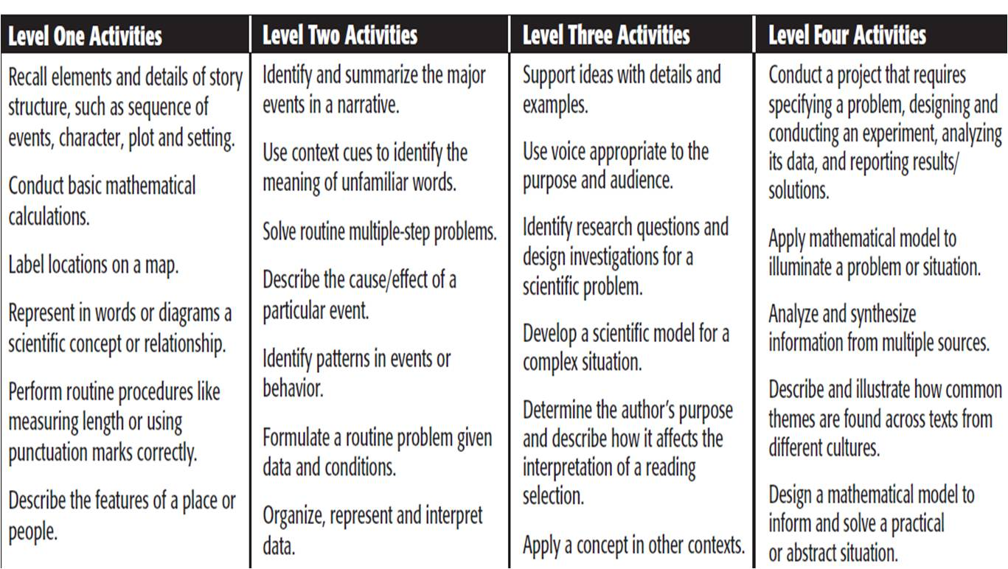
Depth of Knowledge Activities

Slide 44
Cognitive Rigor Matrix – Reading (khess@nciea.org)
Revised Bloom’s Taxonomy | Webb’s DOK Level 1 Recall & Reproduction | Webb’s DOK Level 2 Skills & Concepts | Webb’s DOK Level 3 Strategic Thinking/ Reasoning | Webb’s DOK Level 4 Extended Thinking
Remember Retrieve knowledge from long-term memory, recognize, recall, locate, identify | Recall, recognize, or locate basic facts, details, events, or ideas explicit in texts Read words orally in connected text with fluency & accuracy Define terms
Understand Construct meaning, clarify, paraphrase, represent, translate, illustrate, give examples, classify, categorize, summarize, generalize, infer a logical conclusion), predict, compare/contrast, match like ideas, explain, construct models | Identify or describe literary elements (characters, setting, sequence, etc.) Select appropriate words when intended meaning/definition is clearly evident Describe/explain who, what, where, when, or how | Specify, explain, show relationships; explain why, cause-effect Give non-examples/examples Summarize results, concepts, ideas Make basic inferences or logical predictions from data or texts Identify main ideas or accurate generalizations of texts Locate information to support explicit-implicit central ideas | Explain, generalize, or connect ideas using supporting evidence (quote, example, text reference) Identify/ make inferences about explicit or implicit themes Describe how word choice, point of view, or bias may affect the readers’ interpretation of a text | Explain how concepts or ideas specifically relate to other content domains or concepts Develop generalizations of the results obtained or strategies used and apply them to new problem situations
Apply Carry out or use a procedure in a given situation; carry out (apply to a familiar task), or use (apply) to an unfamiliar task | Use language structure (pre/suffix) or word relationships (synonym/antonym) to determine meaning of words | Use context to identify the meaning of words/phrases Obtain and interpret information using text features | Apply a concept in a new context | Illustrate how multiple themes (historical, geographic, social) may be interrelated
Analyze Break into constituent parts, determine how parts relate, differentiate between relevant-irrelevant, distinguish, focus, select, organize, outline, find coherence, deconstruct (e.g., for bias or point of view) | Identify whether specific information is contained in graphic representations (e.g., map, chart, table, graph, T-chart, diagram) or text features (e.g., headings, subheadings, captions) | Categorize/compare literary elements, terms, facts, details, events Identify use of literary devices Analyze format, organization, & internal text structure (signal words, transitions, semantic cues) of different texts Distinguish: relevant-irrelevant information; fact/opinion Identify characteristic text features; distinguish between texts, genres | Analyze information within data sets or texts Analyze interrelationships among concepts, issues, problems Analyze or interpret author’s craft (literary devices, viewpoint, or potential bias) to critique a text Use reasoning, planning, and evidence to support inferences | Analyze multiple sources of evidence, or multiple works by the same author, or across genres, time periods, themes Analyze complex/abstract themes, perspectives, concepts Gather, analyze, and organize multiple information sources Analyze discourse styles
Evaluate Make judgments based on criteria, check, detect inconsistencies or fallacies, judge, critique |  |  | Cite evidence and develop a logical argument for conjectures Describe, compare, and contrast solution methods Verify reasonableness of results Critique conclusions drawn | Evaluate relevancy, accuracy, & completeness of information from multiple sources Draw & justify conclusions Apply understanding in a novel way, provide argument or justification for the application
Create Reorganize elements into new patterns/structures, generate, hypothesize, design, plan, produce |  | Generate conjectures or hypotheses based on observations or prior knowledge and experience | Synthesize information within one source or text Develop a complex model for a given situation Develop an alternative solution | Synthesize information across multiple sources or texts Articulate a new voice, alternate theme, new knowledge or perspective

Slide 45
Cognitive Rigor Matrix – Writing (khess@nciea.org)
Revised Bloom’s Taxonomy | Webb’s DOK Level 1 Recall & Reproduction | Webb’s DOK Level 2 Skills & Concepts | Webb’s DOK Level 3 Strategic Thinking/ Reasoning | Webb’s DOK Level 4 Extended Thinking
Remember Retrieve knowledge from long-term memory, recognize, recall, locate, identify
Understand Construct meaning, clarify, paraphrase, represent, translate, illustrate, give examples, classify, categorize, summarize, generalize, infer a logical conclusion), predict, compare/contrast, match like ideas, explain, construct models | Describe or define facts, details, terms Select appropriate words to use when intended meaning/definition is clearly evident Write simple sentences | Specify, explain, show relationships; explain why, cause-effect Give non-examples/examples Take notes; organize ideas/data Summarize results, concepts, ideas Identify main ideas or accurate generalizations of texts | Explain, generalize, or connect ideas using supporting evidence (quote, example, text reference) Write multi-paragraph composition for specific purpose, focus, voice, tone, & audience | Explain how concepts or ideas specifically relate to other content domains or concepts Develop generalizations of the results obtained or strategies used and apply them to new problem situations
Apply Carry out or use a procedure in a given situation; carry out (apply to a familiar task), or use (apply) to an unfamiliar task | Apply rules or use resources to edit specific spelling, grammar, punctuation, conventions, word use Apply basic formats for documenting sources | Use context to identify the meaning of words/phrases Obtain and interpret information using text features Develop a text that may be limited to one paragraph Apply simple organizational structures (paragraph, sentence types) in writing | Revise final draft for meaning or progression of ideas Apply internal consistency of text organization and structure to composing a full composition Apply a concept in a new context Apply word choice, point of view, style to impact readers’ interpretation of a text | Select or devise an approach among many alternatives to research a novel problem Illustrate how multiple themes (historical, geographic, social) may be interrelated
Analyze Break into constituent parts, determine how parts relate, differentiate between relevant-irrelevant, distinguish, focus, select, organize, outline, find coherence, deconstruct (e.g., for bias, point of view) | Decide which text structure is appropriate to audience and purpose | Compare literary elements, terms, facts, details, events Analyze format, organization, & internal text structure (signal words, transitions, semantic cues) of different texts Distinguish: relevant-irrelevant information; fact/opinion | Analyze interrelationships among concepts, issues, problems Apply tools of author’s craft (literary devices, viewpoint, or potential dialogue) with intent Use reasoning, planning, and evidence to support inferences made | Analyze multiple sources of evidence, or multiple works by the same author, or across genres, or time periods Analyze complex/abstract themes, perspectives, concepts Gather, analyze, and organize multiple information sources
Evaluate Make judgments based on criteria, check, detect inconsistencies or fallacies, judge, critique |  |  | Cite evidence and develop a logical argument for conjectures Describe, compare, and contrast solution methods Verify reasonableness of results Justify or critique conclusions | Evaluate relevancy, accuracy, & completeness of information from multiple sources Draw & justify conclusions Apply understanding in a novel way, provide argument or justification for the application
Create Reorganize elements into new patterns/structures, generate, hypothesize, design, plan, produce | Brainstorm ideas, concepts, problems, or perspectives related to a topic or concept | Generate conjectures or hypotheses based on observations or prior knowledge and experience | Develop a complex model for a given situation Develop an alternative solution | Synthesize information across multiple sources or texts Articulate a new voice, alternate theme, new knowledge or perspective

Slide 46
Cognitive Rigor Matrix – Math and Science (khess@nciea.org)
Revised Bloom’s Taxonomy | Webb’s DOK Level 1 Recall & Reproduction | Webb’s DOK Level 2 Skills & Concepts | Webb’s DOK Level 3 Strategic Thinking/ Reasoning | Webb’s DOK Level 4 Extended Thinking
Remember Retrieve knowledge from long-term memory, recognize, recall, locate, identify | Recall, observe, & recognize facts, principles, properties Recall/ identify conversions among representations or numbers (e.g., customary and metric measures)
Understand Construct meaning, clarify, paraphrase, represent, translate, illustrate, give examples, classify, categorize, summarize, generalize, infer a logical conclusion (such as from examples given), predict, compare/contrast, match like ideas, explain, construct models | Evaluate an expression Locate points on a grid or number on number line Solve a one-step problem Represent math relationships in words, pictures, or symbols Read, write, compare decimals in scientific notation | Specify and explain relationships (e.g., non-examples/examples; cause-effect) Make and record observations Explain steps followed Summarize results or concepts Make basic inferences or logical predictions from data/observations Use models /diagrams to represent or explain mathematical concepts Make and explain estimates | Use concepts to solve non-routine problems Explain, generalize, or connect ideas using supporting evidence Make and justify conjectures Explain thinking when more than one response is possible Explain phenomena in terms of concepts | Relate mathematical or scientific concepts to other content areas, other domains, or other concepts Develop generalizations of the results obtained and the strategies used (from investigation or readings) and apply them to new problem situations
Apply Carry out or use a procedure in a given situation; carry out (apply to a familiar task), or use (apply) to an unfamiliar task | Follow simple procedures (recipe-type directions) Calculate, measure, apply a rule (e.g., rounding) Apply algorithm or formula (e.g., area, perimeter) Solve linear equations Make conversions among representations or numbers, or within and between customary and metric measures | Select a procedure according to criteria and perform it Solve routine problem applying multiple concepts or decision points Retrieve information from a table, graph, or figure and use it solve a problem requiring multiple steps Translate between tables, graphs, words, and symbolic notations (e.g., graph data from a table) Construct models given criteria | Design investigation for a specific purpose or research question Conduct a designed investigation Use concepts to solve non-routine problems Use & show reasoning, planning, and evidence Translate between problem & symbolic notation when not a direct translation | Select or devise approach among many alternatives to solve a problem Conduct a project that specifies a problem, identifies solution paths, solves the problem, and reports results
Analyze Break into constituent parts, determine how parts relate, differentiate between relevant-irrelevant, distinguish, focus, select, organize, outline, find coherence, deconstruct | Retrieve information from a table or graph to answer a question Identify whether specific information is contained in graphic representations (e.g., table, graph, T-chart, diagram) Identify a pattern/trend | Categorize, classify materials, data, figures based on characteristics Organize or order data Compare/ contrast figures or data Select appropriate graph and organize & display data Interpret data from a simple graph Extend a pattern | Compare information within or across data sets or texts Analyze and draw conclusions from data, citing evidence Generalize a pattern Interpret data from complex graph Analyze similarities/differences between procedures or solutions | Analyze multiple sources of evidence analyze complex/abstract themes Gather, analyze, and evaluate information
Evaluate Make judgments based on criteria, check, detect inconsistencies or fallacies, judge, critique |  |  | Cite evidence and develop a logical argument for concepts or solutions Describe, compare, and contrast solution methods Verify reasonableness of results | Gather, analyze, & evaluate information to draw conclusions Apply understanding in a novel way, provide argument or justification for the application
Create Reorganize elements into new patterns/structures, generate, hypothesize, design, plan, construct, produce | Brainstorm ideas, concepts, or perspectives related to a topic | Generate conjectures or hypotheses based on observations or prior knowledge and experience | Synthesize information within one data set, source, or text Formulate an original problem given a situation Develop a scientific/mathematical model for a complex situation | Synthesize information across multiple sources or texts Design a mathematical model to inform and solve a practical or abstract situation

Slide 47
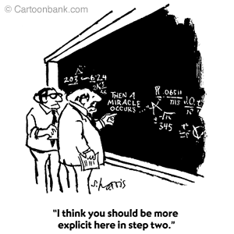

Slide 48
What is Universal Design?

Slide 49
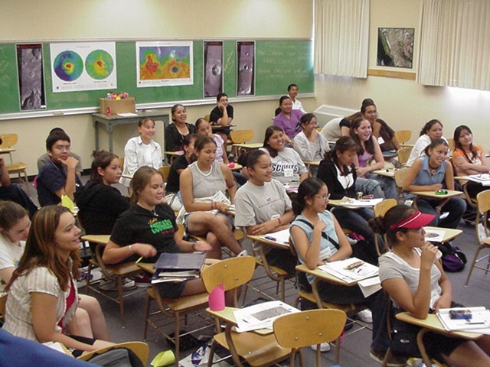
What is Universal Design?
Is our learning environment welcoming?
UDL is the proactive design of curriculum and instruction to ensure they are educationally accessible regardless of learning style, physical or sensory abilities.
Just as physical barriers exist in our physical environment, curricular barriers exist in our instructional environment.

Slide 50
How is Universal Design Defined?
The term UDL means a scientifically valid framework for guiding educational practice that:
Provides flexibility in the ways information is presented (recognition), in the ways students respond or demonstrate knowledge and skills (action and expression), and in the ways students are engaged (engagement); and

Slide 51
How is Universal Design Defined?
The term UDL means a scientifically valid framework for guiding educational practice that:
…reduces barriers in instruction, provides appropriate accommodations, supports, and challenges, and maintains high achievement expectations for all students, including students with disabilities and students who are English Language Learners. (Higher Education Opportunity Act of 2008)

Slide 52
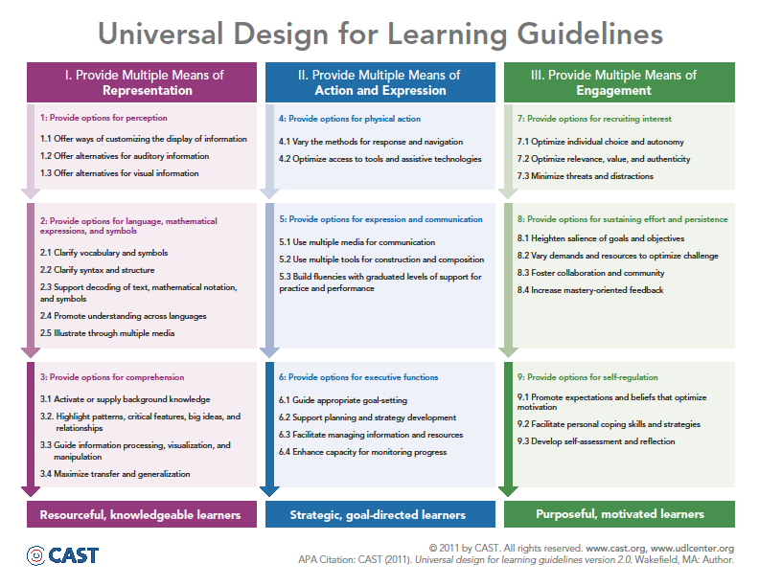

Slide 53
UDL In Action

Slide 54
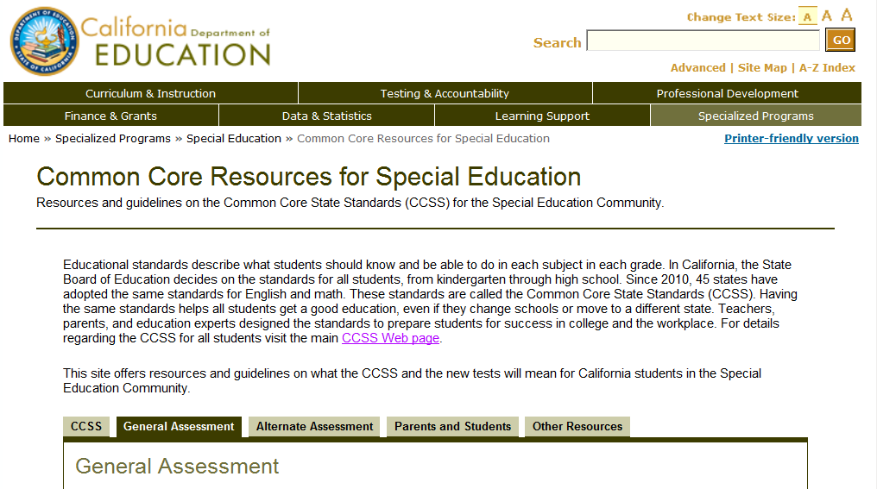
http://www.cde.ca.gov/sp/se/cc/

Slide 55
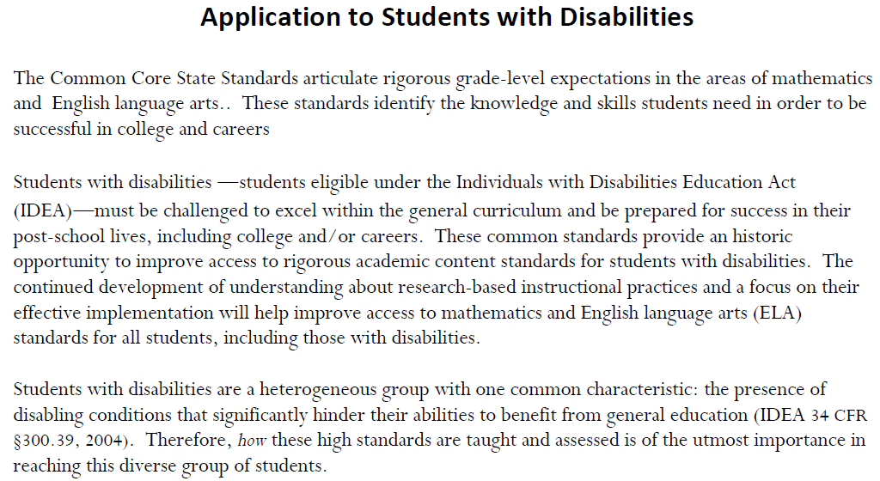
http://www.corestandards.org/assets/application-to-students-with-disabilities.pdf

Slide 56
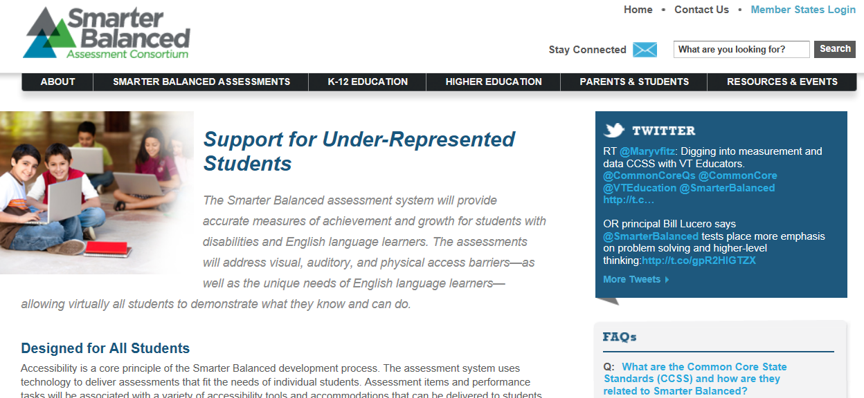
http://www.smarterbalanced.org/parents-students/support-for-under-represented-students/

Slide 57
http://www.smarterbalanced.org/wordpress/wp-content/uploads/2013/09/SmarterBalanced_Guidelines_091113.pdf

Slide 58
http://www.leadered.com/pdf/Special%20Ed%20&%20CCSS%20white%20paper.pdf

Slide 59
http://www.ncscpartners.org/resources

Slide 60
http://www.achievethecore.org/common-core-intro-for-parents

Slide 61
“People don't buy what you do, they buy why you do it.” - Simon Sinek TEDTalk - How Great Leaders Inspire Action

